Slide 1
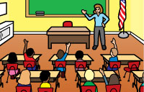
In the CLASSROOM we are...
Respectful | Accountable | Motivated | Successful
Quietly listen to directions without interrupting. Follow dress code. Allow others to learn. Raise hand to speak. | Accept consequences for your behavior. Keep track of assignments and deadlines. Make up absent work promptly. Use technology appropriately. | Earn your best grade. Be proactive in seeking help. Stay on task & encourage others to stay on task also. | You are showing growth! You are a peer tutor! You are a role model & leader for others! You are eligible for extracurricular activities.

Slide 2
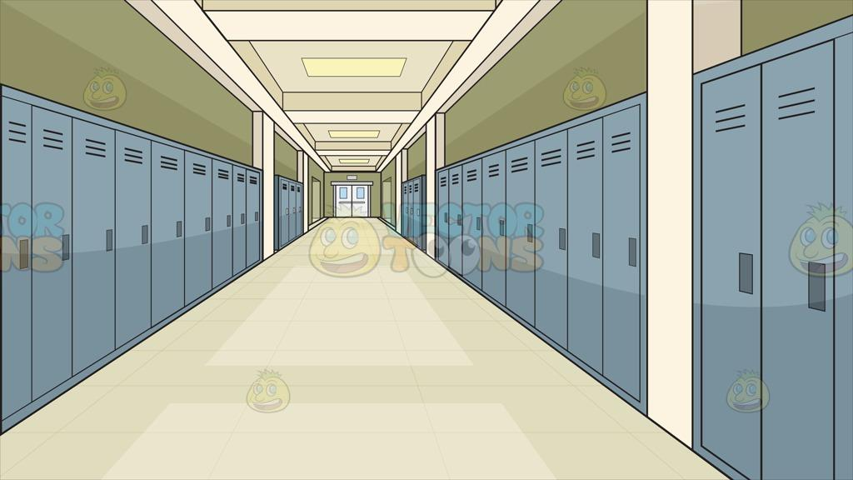
In the HALLWAY we are...
Respectful | Accountable | Motivated | Successful
Hold doors open for others. Hands and feet to self. Walk and be aware of those around you. Help others when they drop their things. | Apologize if you bump into someone. Keep hallway/lockers clean. Walk quietly. Travel to class instead of standing in the hall. | Get to class before the tardy bell rings. Only stop at locker for dropping off and picking up necessary materials. | You are arriving to class on time! You are getting compliments and positive responses from others.

Slide 3
In the RESTROOM we are...
Respectful | Accountable | Motivated | Successful
Pick up all paper towels and trash. Flush toilet when finished. Dispose of personal products appropriately. | Wash hands and turn off water. Use before school, between classes, or when an emergency during class. Report any problems to the office, custodian, or teacher. | Finish business quickly and return to class because you’re missing important educational opportunities. | You are using time for the right reasons, not work avoidance.

Slide 4
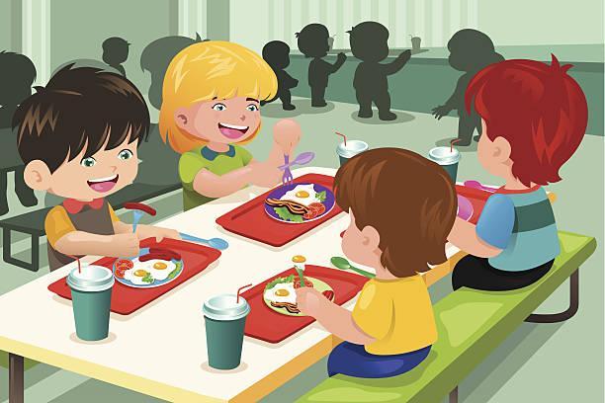
In the CAFETERIA we are...
Respectful | Accountable | Motivated | Successful
Use manners in line and at the table. “Please” and “Thank You”. Use appropriate language. Help maintain cafeteria equipment and supplies. Keep hands and feet to yourself. Stay in one seat | Clean up own messes. Keep voice at appropriate volume (across the table--not across the room). Get permission from a teacher to leave the cafeteria. | Sit with someone eating alone. Treat others the way you want to be treated. Create a positive atmosphere. | You are appreciated by others! You are re-energized for learning!

Slide 5
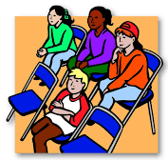
At an ASSEMBLY we are...
Respectful | Accountable | Motivated | Successful
Enter quietly. Stay seated where directed. Keep food and beverages for another time and place. Allow others to listen and enjoy the presentation. | Applaud and thank the speaker for coming. Participate appropriately. | Encourage friends to listen. Make a connection to speaker and what is being said. | You are able to learn something new. You are able to apply new skills!

Slide 6
In the LIBRARY we are...
Respectful | Accountable | Motivated | Successful
Keep volume at a low level. Take care of school materials. | Return materials by due date. Return materials in original condition. | Focus and get work done in a quiet area. Read to learn something new or find something you enjoy. | You find a new book to enjoy! Recommend a favorite book to someone who can’t find something they want! You are able to learn an abundance of new things!

Slide 7
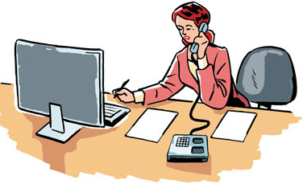
In the OFFICE we are...
Respectful | Accountable | Motivated | Successful
Enter quietly. Wait in line to be helped, ask nicely. Speak quietly and respectfully. “Please” and “Thank you” are important. | Accept consequences without arguing. | Give/get information quickly and return to class. | You can honestly reflect on the purpose of being in the office! You do not return for repeated negative behaviors! You are able to accomplish what you need to.

Slide 8
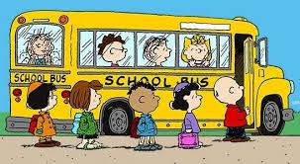
On the BUS we are...
Respectful | Accountable | Motivated | Successful
Quiet voices--talk to the people directly across from you, not those across the bus. Listen to & follow directions quickly and quietly. | Pick up after yourself. Stay in your seat. Remember to take everything with you. | Be on time to get on the bus. Think safety first before you act. | You engage in positive actions that keep everyone safe! You are a role model for friends to follow safety rules!

Slide 9
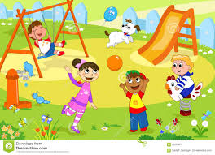
When OUTSIDE we are...
Respectful | Accountable | Motivated | Successful
Keep hands off of others’ property. Treat school equipment with care. | Stay in designated area unless given permission. Throw away trash. Keep track of your property. | Follow rules to remain outside--going outside is a privilege. | You take pride in your school building and property! You are invited to go back outside!

Slide 10
In TEAM TIME we are...
Respectful | Accountable | Motivated | Successful
Sit in your seat. Work quietly. Check your work before you check your phone. Follow teacher’s rules to begin the day. | Be on time to school. Gather materials to become prepared for school. Check Google Classroom. | Check over homework. Ask for missing work or make up work from absences. | You have all homework complete! You accomplish tasks quickly! You are ready and prepared to learn!

